Slide 1

Microsoft 365 platform community call
aka.ms/m365pnp
Your host in this call: Vesa Juvonen
May 24, 2022

Slide 2
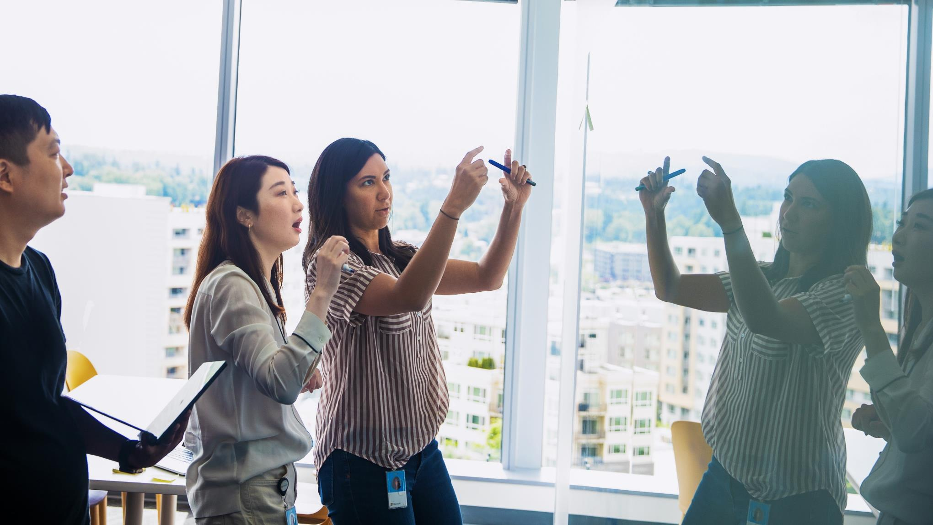

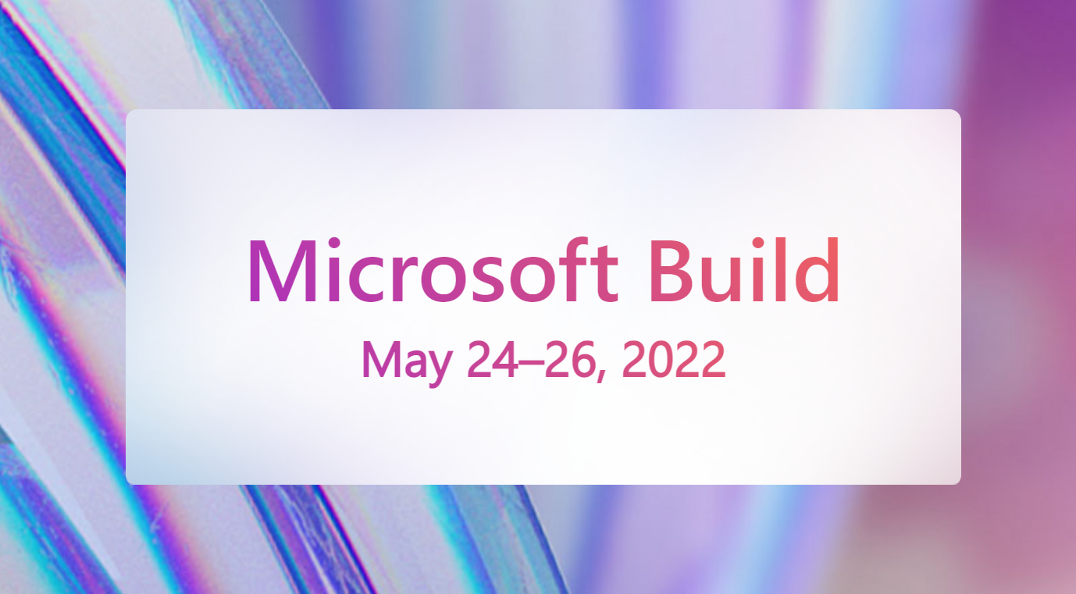
Agenda
Quick recap on the latest updates and news on the Microsoft 365 platform
Gloria Sanchez Hernandez - Introduction to Microsoft Viva ISV benefits program
Build 2022 Watch Party – Let’s hang on the line for shared discussions on the focus areas and announcements.
Satya Nadella’s Keynote starts at 8:15 AM PT

Slide 3
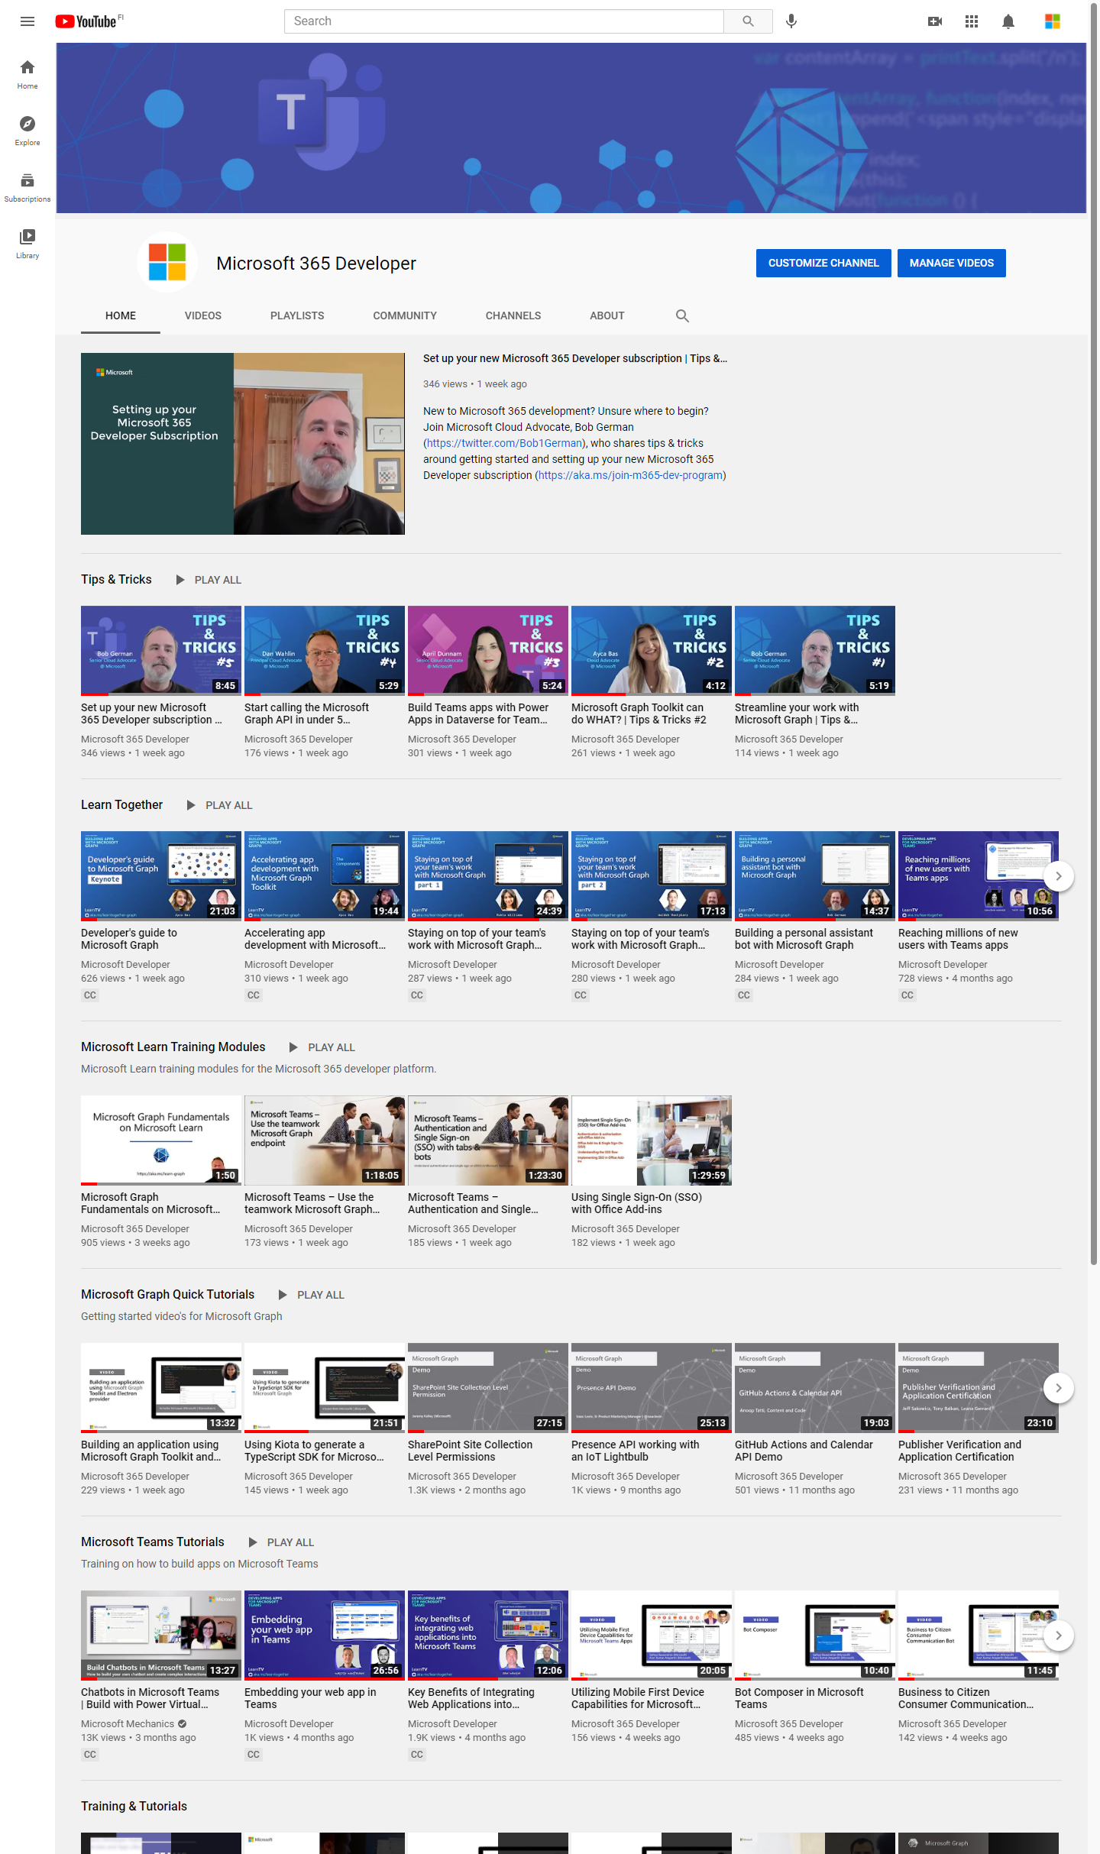
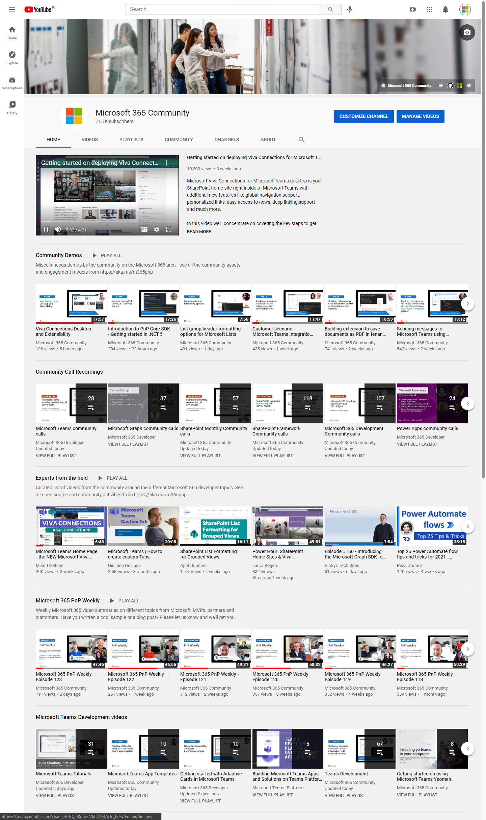
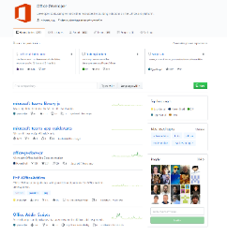
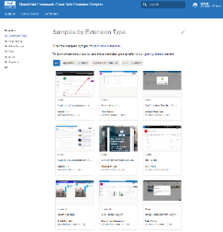
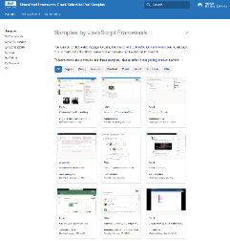
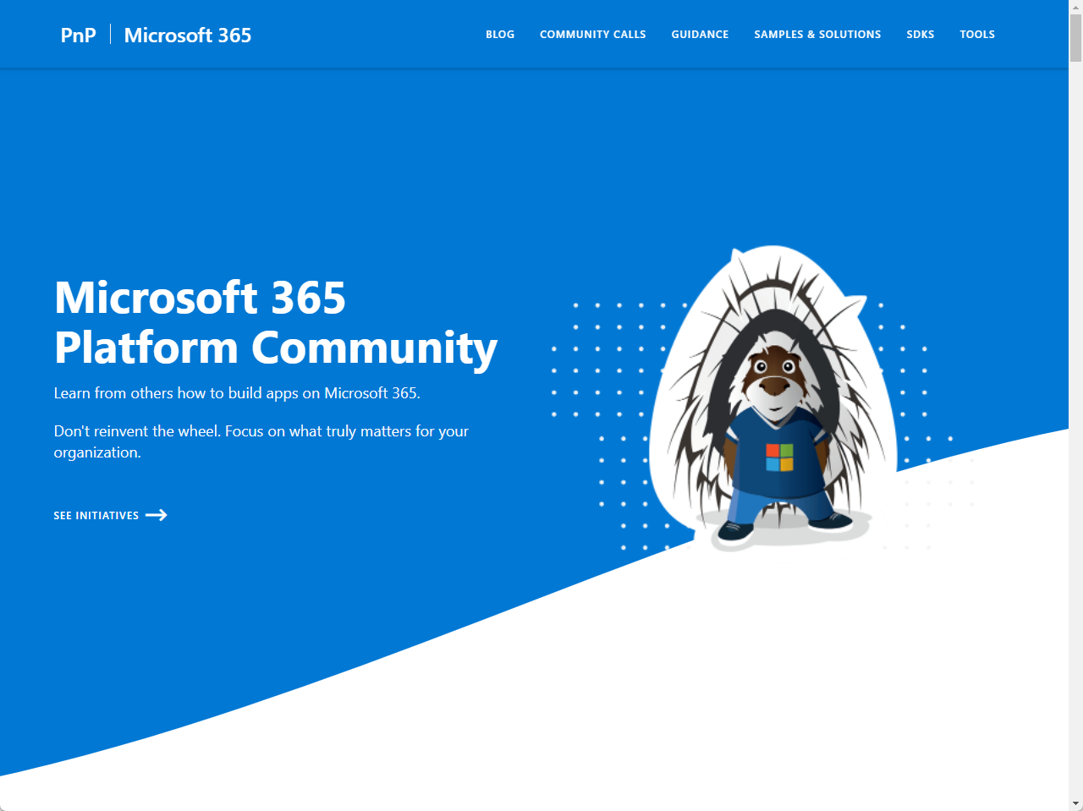
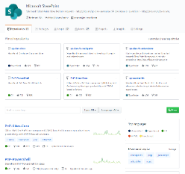
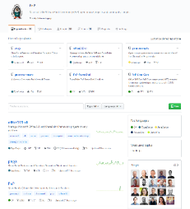
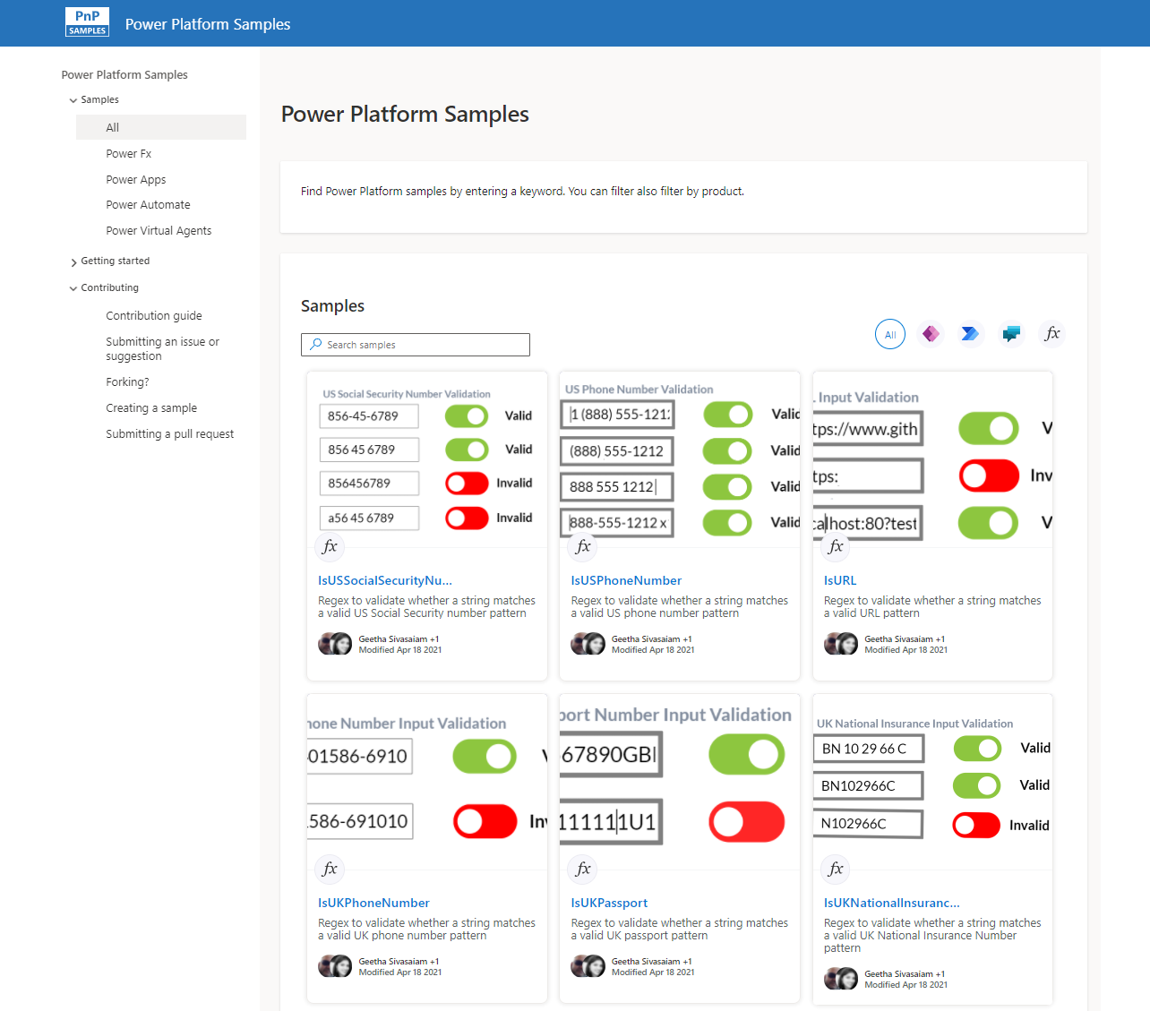
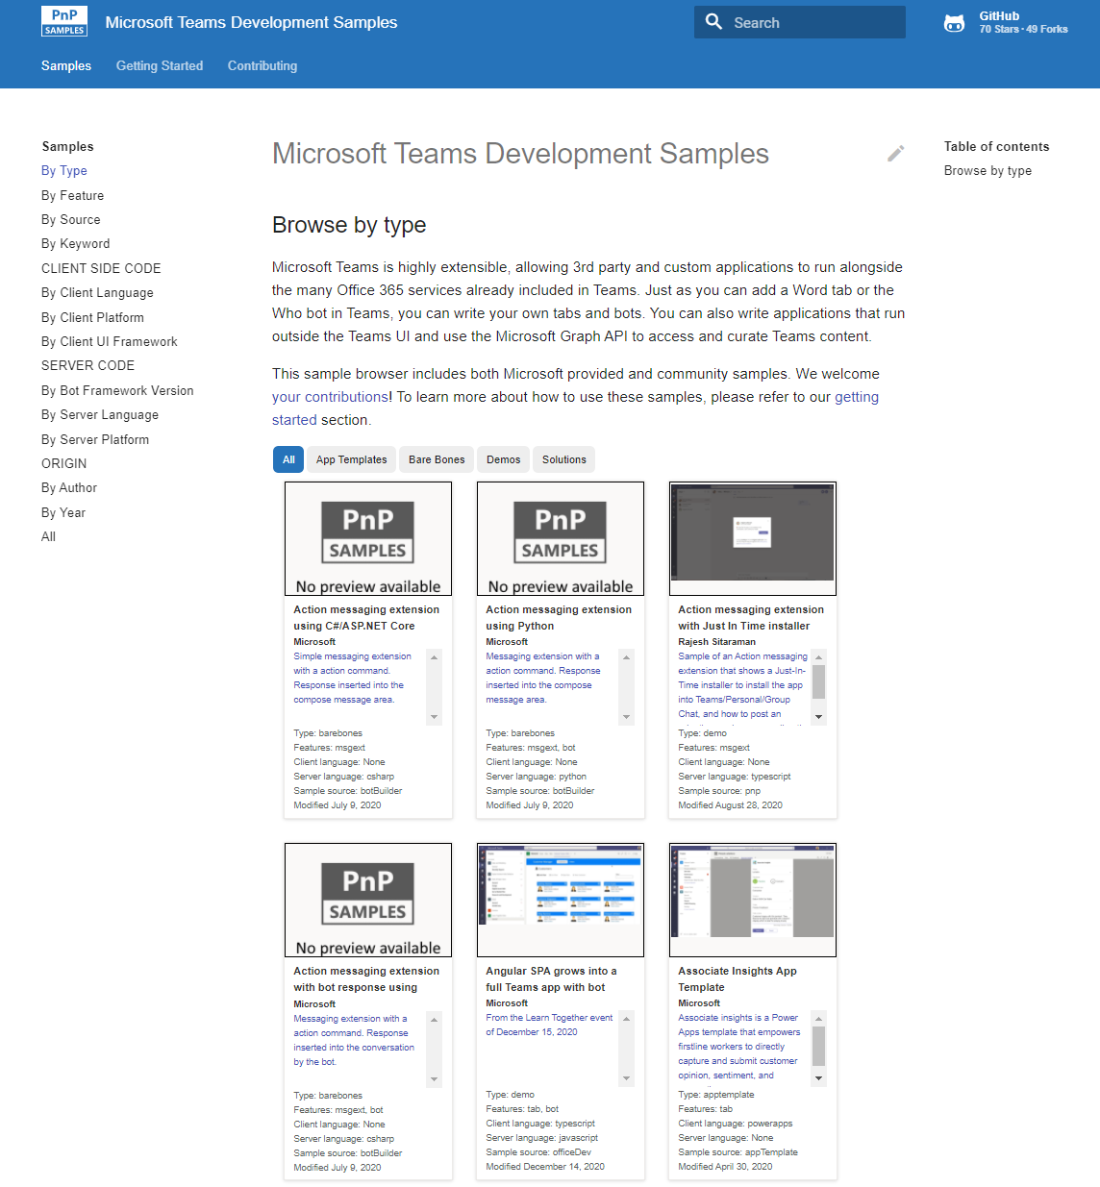
Microsoft 365 developer videos
Microsoft 365 community videos
Open-source
Sample galleries
Open-source initiatives and samples
aka.ms/m365devyoutube
aka.ms/m365/videos
github.com/pnp
github.com/officedev
github.com/sharepoint
github.com/microsoftgraph
aka.ms/m365/samples
aka.ms/teams-samples
aka.ms/spfx-webparts
aka.ms/powerplatform-samples
aka.ms/spfx-extensions
aka.ms/list-formatting
aka.ms/m365/community
@Microsoft365Dev | @m365pnp

Slide 4
Microsoft 365 developer community calls
Microsoft 365 platform (weekly) https://aka.ms/m365-dev-call
(Notice. This call is on a summer break between July 1st and 31st of August 2022)
Adaptive Cards https://aka.ms/adaptivecardscommunitycall
Microsoft identity platform https://aka.ms/IDDevCommunityCalendar
Office Add-ins https://aka.ms/officeaddinscommunitycall
Power Platform https://aka.ms/PowerAppsMonthlyCall
Microsoft 365 and Power Platform community (bi-weekly) https://aka.ms/m365-dev-sig
Viva Connections & SharePoint Framework (bi-weekly) https://aka.ms/spfx-call
Download recurrent invites from
https://aka.ms/m365/calls
Notes:
m365-dev-sig

Slide 5

https://aka.ms/m365dev/blog
https://aka.ms/teams/blog
https://aka.ms/microsoftviva/blog
Build announcements are currently rolling to blogs…
Notes:
New pull as needed sync model for content types along with APIs
Recap news and announcements from Enterprise Connect including Teams Rooms, RSVP options for hybrid meetings, and more
Follow up to initial customer story with Atlassian to dive deeper into Teams app
Tips and tricks for using Power Automate to track and collaborate on tasks

Slide 6
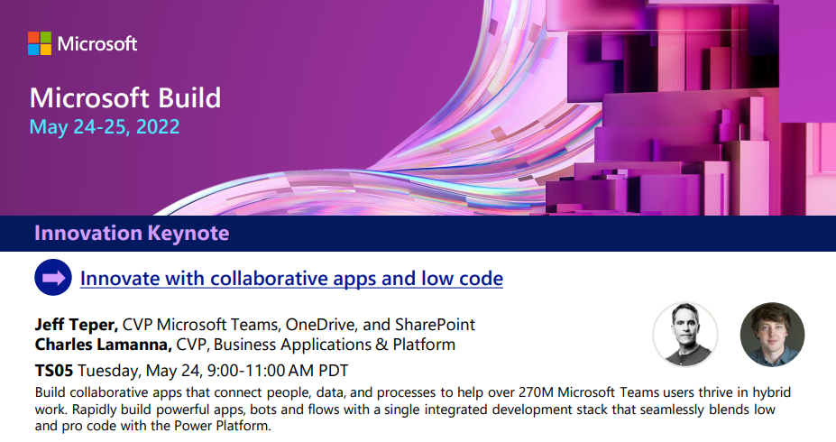

SCHEDULE
Collaborative Apps session introduction now available
Breakout sessions, on demand videos, Ask The Experts, Product Roundtables and more… 🚀
https://aka.ms/teamssessions

Slide 7
Watch party model and guidance for today
Register to Build at https://build.microsoft.com
Check the schedule also for other sessions
Watch the live feed of the keynote from https://build.microsoft.com
Let’s use the chat in this call to discuss the announcements – give your feedback and input
Keynote schedule – 8:15 AM – 9:10 AM PT

Slide 8

TOPIC
Introduction to Microsoft Viva ISV benefits program
- Gloria Sanchez Hernandez
Microsoft Build 2022 keynote watch party
Watching from your own device, let’s comment the announcements in the chat
Let us know your reactions on the announcements

Slide 9
Watch party model and guidance
Register to Build at https://build.microsoft.com
Check the schedule also for other sessions
Watch the live feed of the keynote from https://build.microsoft.com
Let’s use the chat in this call to discuss the announcements – give your feedback and input in written format
Keynote schedule – 8:15 AM – 9:10 AM PT
aka.ms/m365/community

Slide 10
Thank you
Recording will be available in 24 hours on
Microsoft 365 Community (PnP) YouTube channel
https://aka.ms/m365/videos
(subscribe today)
Follow us on Twitter
@Microsoft365Dev | @M365PnP
Next Microsoft 365 Platform call: May 31st at 08:00 am PT
All available community calls from https://aka.ms/m365/calls
aka.ms/m365/community

Slide 11
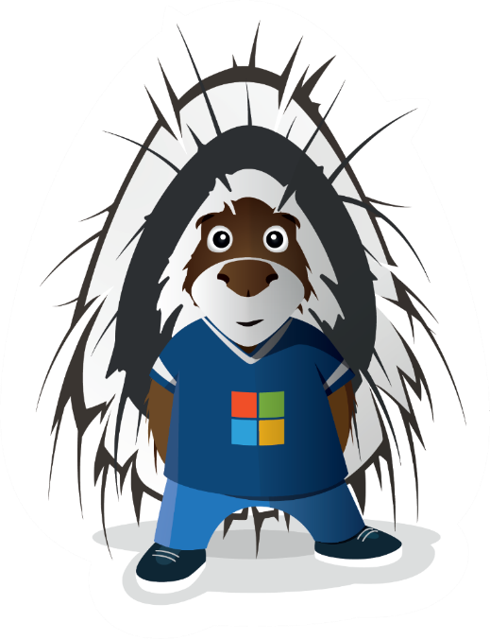


aka.ms/m365/community

